Slide 1
SIX WEEK SUMMER TRAINING PRESENTATION
ON
ADVANCED PYTHON PROGRAMMING
Presented by: Siddharth Rathore
Registration No: 12100767
Section: K20BG
Course Code: CSE343

Slide 2
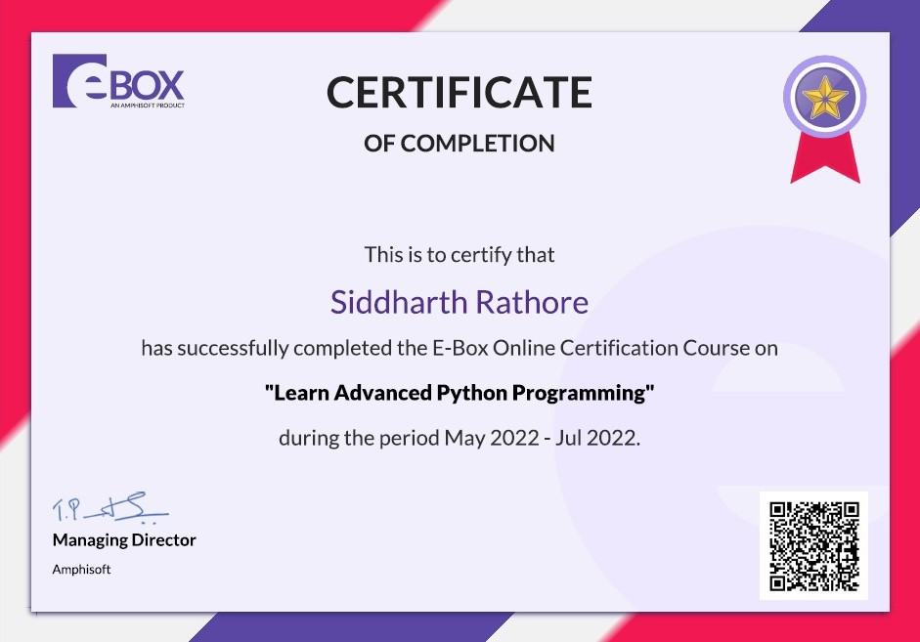
CERTIFICATE

Slide 3
TABLE OF CONTENTS
01
02
03
04
Introduction to Summer Training
Why this Course ?
What have I learnt ?
05
Mini Project
Certificate

Slide 4

INTRODUCTION TO SUMMER TRAINING
In this six week of summer training, I’ve learnt about advance python by eBox an Amphisoft product which have variety of other programming courses.
In my course “Learn Advance Python”, we have 9 topics, and have 55 hours of recorded video lectures, which contains 87 coding-based questions and 256 quiz questions, every topic has some subtopics. Each topic has videos, quizzes, and coding-based questions to solve.
At the end I’ve prepared a Mini Project on Billing Management System. (Used to generate invoices/bill)

Slide 5

WHY THIS COURSE ?
Python is general-purpose programming language.
It is currently the most famous programming language and being used in Variety of different fields like Data Science & ML, etc.
In advance python it starts from Class and Object, Inheritance till Lambda functions.
This course helped me learn Python in advanced level. The course curriculum has been divided into Six weeks where one can learn the concepts from videos & attempt the programming questions and quizzes.

Slide 6
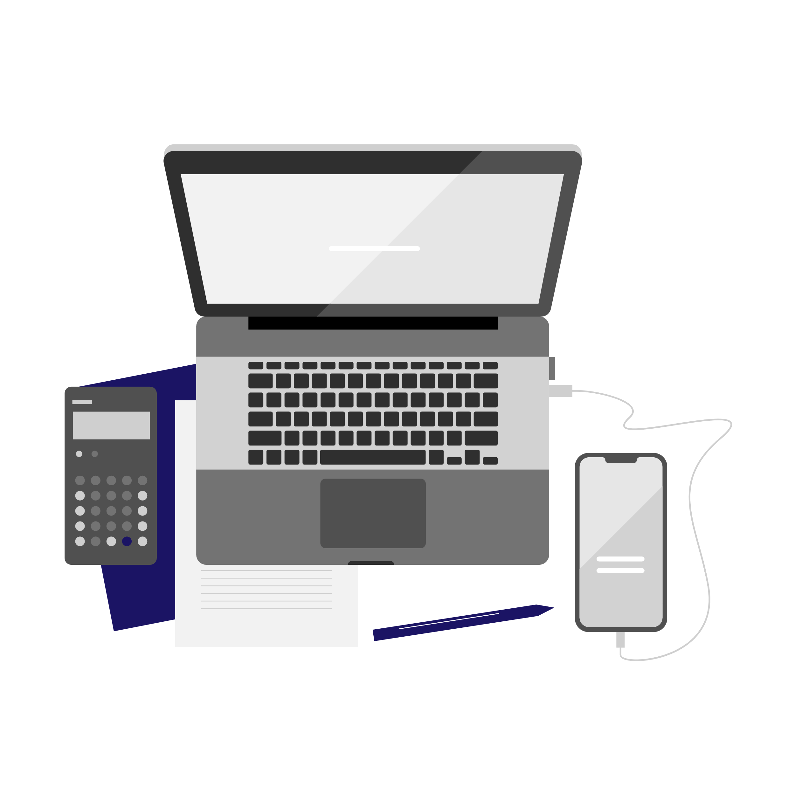
WHAT HAVE I LEARNT ?
From Six Week of summer training in Advance Python, I have learnt the concept of object-oriented programming.
Learnt about class and object and its method of encapsulation.
Capabilities of Inheritance.
Practice of coding questions and quizzes.

Slide 7
MINI PROJECT
Billing Management System will help the shop managers to manage the shop more effectively and efficiently by computerizing product ordering, which makes the way of generating the invoice simple compared to the manual calculations.
• It will generate receipt on every transaction input to the system.
• The software will display view of calculations of every transaction.
• The system will store and recognize customer details.
• By giving bill id it fetches the customer order details.
I have also used GUI(Graphic User Interface) for better representation to this project.

Slide 8
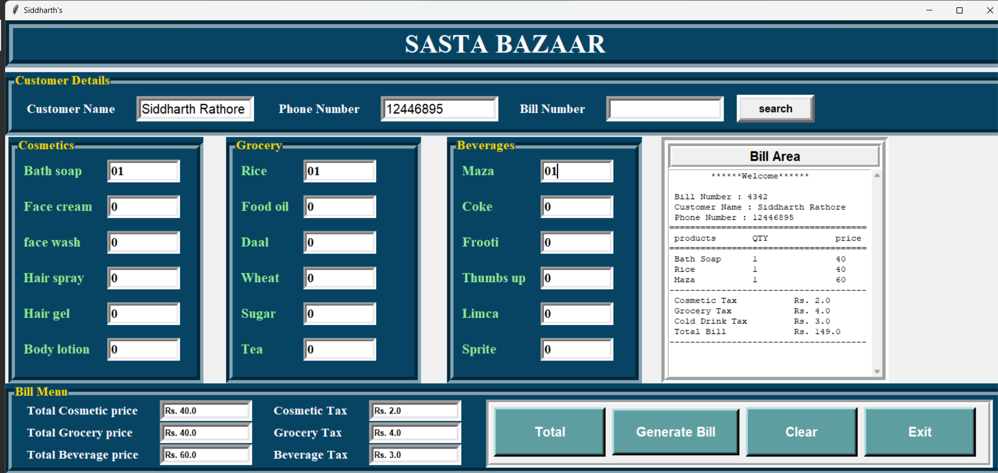

Slide 9
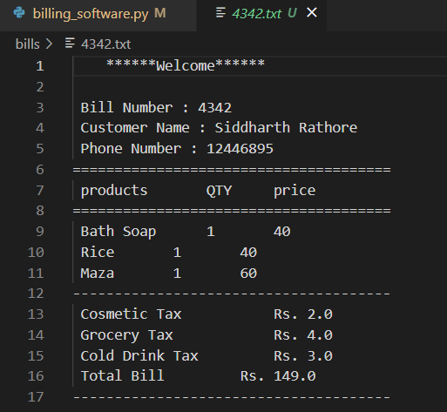

Slide 10
THANK YOU!

